Slide 1
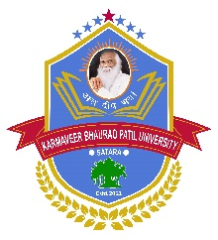

Yashavantrao Chavan Institute of Science, Satara
A Constitute of College of Karmaveer Bhaurao Patil University, Satara
Reaccredited by NAAC (4th Cycle) with A++ Grade (CGPA 3.61)
Grant-in-aid courses
30 undergraduate programmes designed as per NEP-2020
Diploma and skill courses along with UG degree
Four year B. Sc. Degree (Honours and Honours with Research) as per NEP-2020
Academically trained, research focused faculty
State-of-the-art infrastructure with Cutting-edge facilities designed for academic and research excellence
Exceptional academic and research credentials
Research training, On-Job-Training, workshops, conferences, hands-on-training for students
Scholarships as per government rules and also available through institutional and corporate sources
Earn and Learn scheme,
Admissions Open
2025-2026
Contact for more Details | Online Enrollment | Documents Required
Fill the admission form available on the official website
Submit hardcopy along with required documents to the college office
Merit list will be announced on the college website
Dr. M. L. Ahire
Chairman
Admission Committee
Dr. D. D. Namdas
Vice Principal
YCIS, Satara
Dr. J. J. Chavan
Vice Principal
YCIS, Satara
Dr. B. T. Jadhav
Principal
YCIS, Satara

